Slide 1

EMPLOYEE DATA ANALYSIS WITH EXCEL
STUDENT NAME :B THREENATH BABU
REGISTER NO:asunm110312201425
NM ID :94EB8E0CABBE953BF874FED84EAC57FA
DEPARTMENT : Iii B COM GENERAL
COLLEGE :D.R.B.C.C.C.HINDU COLLEGE, PATTABIRAM

Slide 2
PROJECT TITLE
EMPLOYEE PERFORMANCE ANALYSIS WITH EXCEL

Slide 3

AGENDA
PROBLEM STATEMENT
PROJECT OVERVIEW
END USERS
OUR SOLUTIONS AND PROPOSITION
DATASET DESCRIPTION
MODELLING APPROACH
RESULT AND DISCUSSION
CONCLUSION
AGENDA

Slide 4
PROJECT STATEMENT
To create a comprehensive and user-friendly Excel-based system for evaluating and analyzing employee performance within an organization. This system will allow employers to track key performance indicators (KPIs), assess individual employee contributions, identify areas for improvement, and generate reports for informed decision-making.

Slide 5
PROJECT OVERVIEW
To develop an Excel-based performance tracking system that allows management to assess employee performance across various metrics, enabling data-driven decisions for workforce management and improvement.

Slide 6
END USERS
KPI (Key Performance Indicator): Key metrics like revenue per employee.
TAT (Turnaround Time): Time taken to complete tasks
Attrition Rate: Employee turnover percentage
Engagement Score: Employee satisfaction/engagement survey results
.Productivity: Output per employee or per team.

Slide 7
OUR SOLUTION AND PROPOSITION
Custom Template: Offer a pre-designed, customizable template to fit different industries or roles.
Real-Time Updates: Incorporate Excel's live collaboration feature to allow multiple managers to track and update performance data in real time
Integration with Other Tools: Propose integration with HR or time-tracking software for automated data input

Slide 8
DATASET DESCRIPTION
Employee IDDescription: A unique identifier for each employee.Type: Numeric or alphanumeric.
Employee NameDescription: Full name of the employee being evaluated.
Type: Text.DepartmentDescription: The department or division the employee works in.Type: Text (e.g., "Sales", "Marketing", "HR").

Slide 9
MODELLING APPROACH
To model employer performance in Excel,
you can use a combination of quantitative metrics and qualitative assessments.
The approach typically involves data collection, the creation of performance indicators, analysis using Excel functions, and visualization through charts and graphs. Here’s a structured approach.

Slide 10
MODELLING APPROACH
Input the necessary data for each KPI. Use different sheets to organize data for different KPIs or departments
For example, you might have columns for:
Employee
IDDepartment
Satisfaction Score
ProductivityLevel
Training Completion date
DateRetention Data

Slide 11
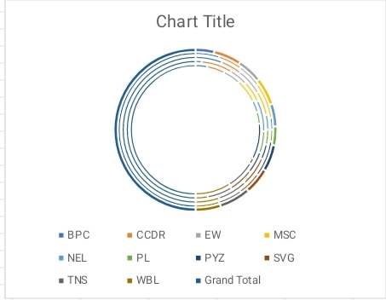
Result

Slide 12
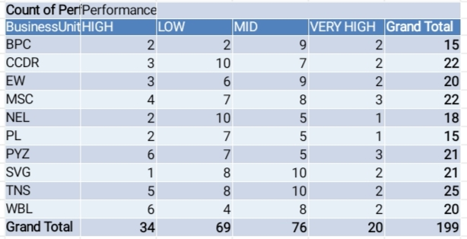
Result

Slide 13
CONCLUSION
In conclusion, Excel is an effective tool for evaluating and analyzing employee performance. It allows employers to track key performance indicators (KPIs), visualize data through charts and graphs, and conduct comprehensive performance reviews. By using formulas and functions, performance data can be easily categorized, analyzed, and compared over time, leading to informed decision-making regarding promotions, training needs, and productivity improvements. Excel’s flexibility makes it suitable for businesses of all sizes to manage employee performance efficiently.

